Slide 1
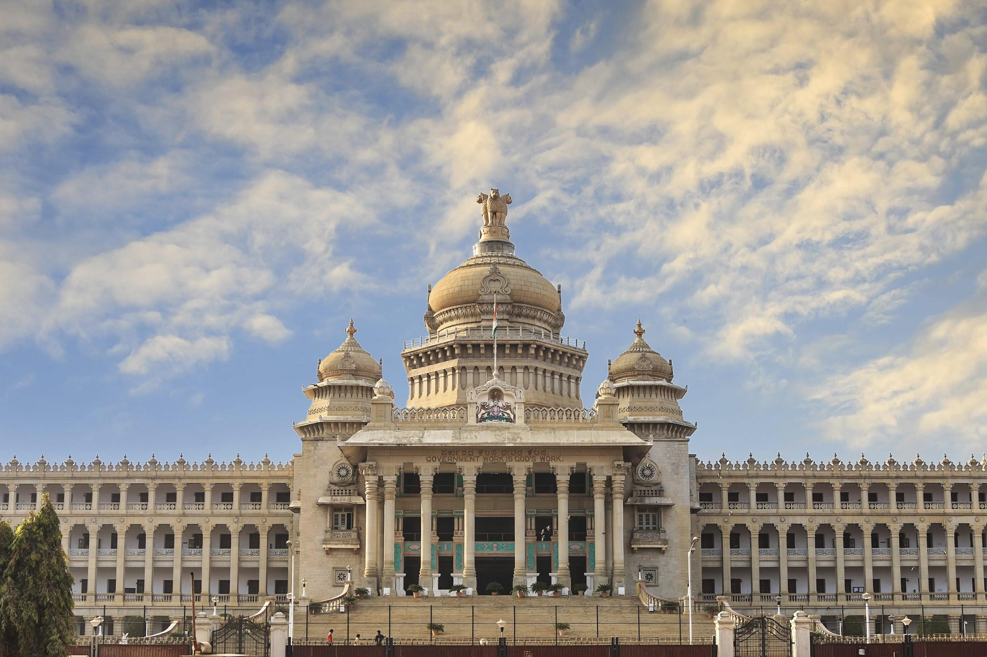
Best IAS Mains Coaching in Bangalore
Which is best ias mains coaching in Bangalore
Which is Rank 1 IAS Mains Coaching in Bangalore
Which is Best ias mains coaching in Bangalore as per study material
Which is best ias mains coaching in Bangalore, Karnataka as per Fees
Which is best ias Coaching in Bangalore as per Reviews

Slide 2
Best IAS Mains Coaching in Bangalore
Which is best ias mains coaching in Bangalore
Which is Rank 1 IAS Mains Coaching in Bangalore
Which is Best ias mains coaching in Bangalore as per study material
Which is best ias mains coaching in Bangalore, Karnataka as per Fees
Which is best ias Coaching in Bangalore as per Reviews

Slide 3
Best IAS Mains Coaching in Bangalore
Which is Rank 1 IAS Mains Coaching in Bangalore
Which is best ias Coaching in Bangalore as per Reviews

Slide 4
Best IAS Mains Coaching in Bangalore
Which is best ias mains coaching in Bangalore, Karnataka as per Fees

Slide 5
Best IAS Mains Coaching in Bangalore
Which is best ias mains coaching in Bangalore

